Slide 1
ITAI 1378 Course Portfolio
Computer Vision
Professor McManus
ITAI 1378

Slide 2
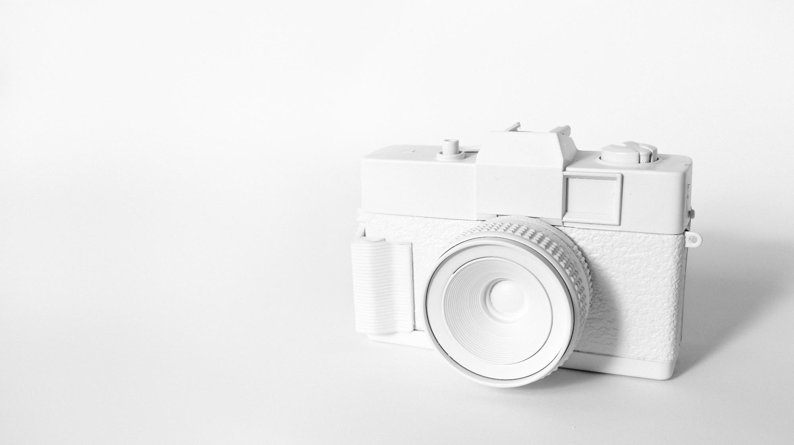
CONTENTS
Lab 1: Facial Recognition
Facial recognition technology uses advanced software to identify individuals based on their facial features, revolutionizing security, authentication, and identification. It operates through three main components: detection, analysis, and recognition, using computer vision to map facial features and create a unique "face-print" for comparison. Widely used in biometric security and applications like Face ID, it offers efficiency and convenience while reducing unauthorized access risks. However, challenges like aging, facial changes, and potential misuse of data raise concerns about accuracy and privacy. Future developments, such as driver monitoring for safety and locating missing persons, highlight its potential for positive societal impact, despite ethical and trust issues.

Slide 3



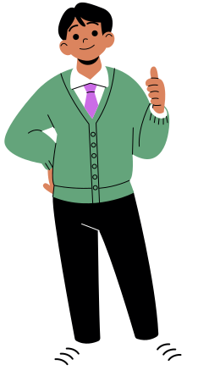
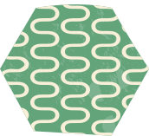
A Day in my Life as a Developer....
Neida Guzman , Niki Vahdati Panah, Jonathan Smith, Tolulope Ogundeji

Slide 4

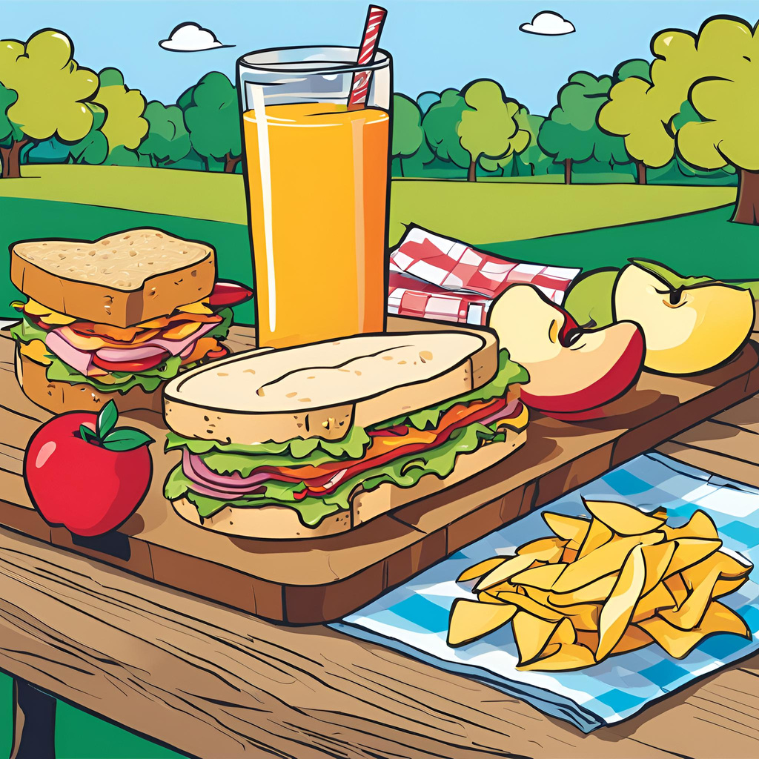

12:30pm
Lunch time! Enjoying my delicious food yet I cannot stop thinking about my task involving Pillow and Open CV.

Slide 5
CONTENTS
Lab 3: GitHub
I explored GitHub by creating an account, setting up a public repository named "Jupyter-exploration," and uploading a Jupyter Notebook titled *My_First_Notebook.ipynb*. I learned key GitHub concepts, including repositories, commits, branches, pull requests, merging, forking, and cloning, while understanding their roles in version control and collaboration. Using Anaconda, I launched JupyterLab to write and execute Markdown and code, saving my work and uploading it to GitHub. Despite initial challenges running the code in Jupyter Notebook, I successfully resolved them in JupyterLab and gained hands-on experience with GitHub’s features for project management and collaboration. add the title

Slide 6
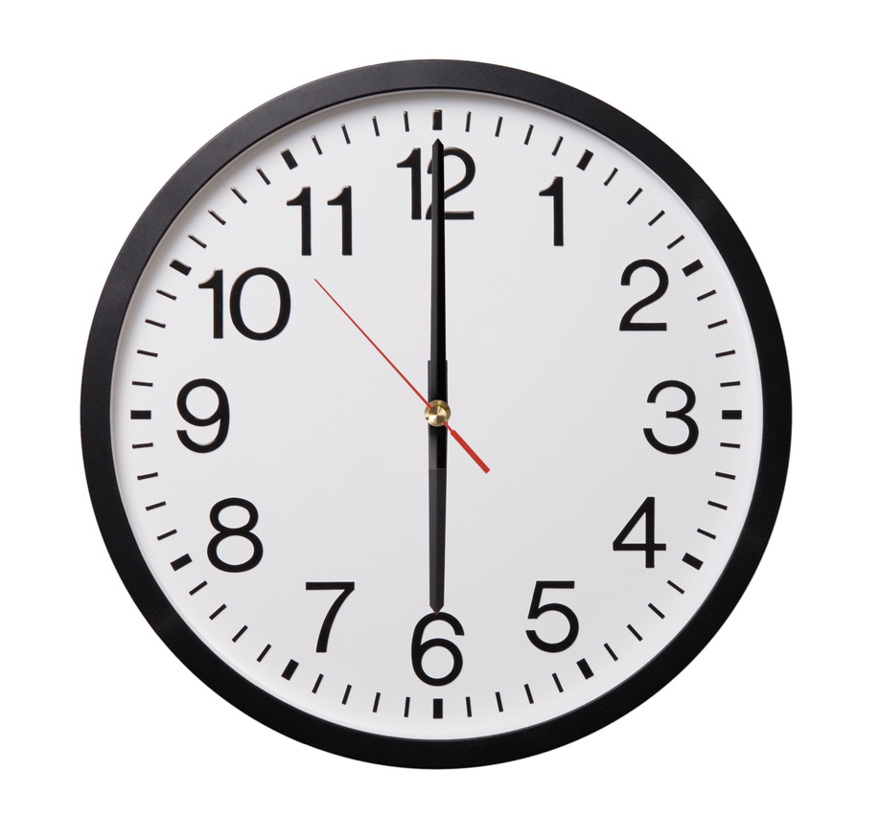
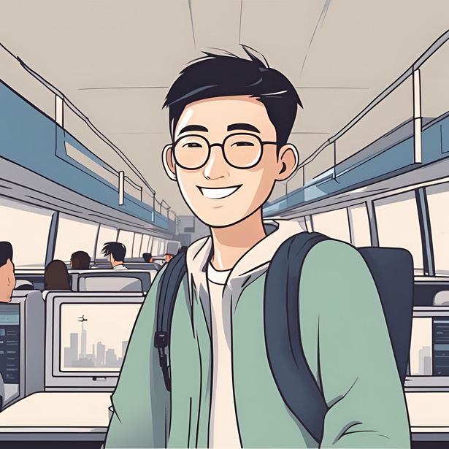
It is now 6pm, reflecting on today's accomplishments, it's clear that diving into OpenCV and Pillow has been highly rewarding. OpenCV, with its powerful capabilities for real-time computer vision, has expanded my understanding of image processing, object detection, and facial recognition.
I am heading home with a huge feeling of accomplishment as today was a productive day as usual, I am going to end the day reflecting on what I learned using OpenCV and pillow. Cannot wait for another day of coding tomorrow.

Slide 7
CONTENTS
Assignment 4: Image Processing
In this assignment, we explored image processing techniques, focusing on the applications and capabilities of OpenCV and Pillow. We learned about image enhancement, restoration, segmentation, and compression, applying methods like histogram equalization, smoothing, and sharpening. As part of a storybook project, we depicted a developer’s workday, showcasing how OpenCV and Pillow are used for tasks such as grayscale conversion, contrast adjustment, resizing, and real-time frame processing. OpenCV was ideal for advanced filtering and transformations, while Pillow excelled at simpler manipulations like resizing. Collaborating on Canva, our team effectively combined efforts to complete the project and reflect on our learnings.

Slide 8
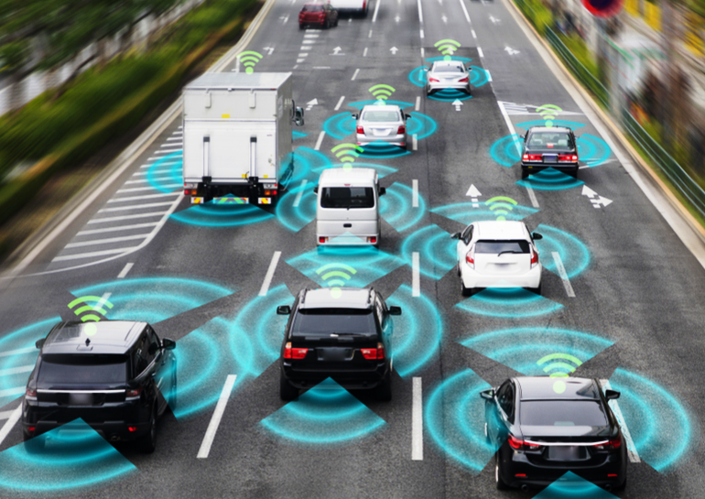
Image generation and computer vision are closely related fields, computer vision serves as the foundation for image generation, and in recent years, both technologies have been integrated in many applications such as:
Autonomous vehicles
Medical imaging
Creative arts.

Slide 9
CONTENTS
Lab 5: Sum Classfier
In this lab, we used Jupyter Lab on AWS SageMaker StudioLab to leverage its GPU capabilities for machine learning tasks. After installing necessary Python libraries like TensorFlow, NumPy, and Matplotlib, we used TensorFlow to access and analyze datasets, categorizing images into labeled classes. We created subsets of training data for binary classification, filtered data using `np.sin()`, and visualized the results with Matplotlib's `pyplot` module. Images were displayed in grayscale and color, and we analyzed their shapes and categories. A Support Vector Machine (SVM) was trained to classify tasks and evaluate model accuracy with detailed reports. Despite initial GPU access issues on Google Colab, SageMaker's robust GPU capabilities provided an efficient environment for training and testing machine learning models.

Slide 10
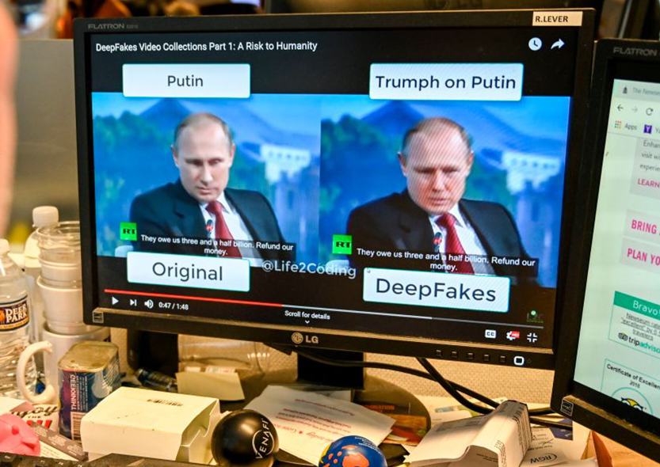
2020: Deepfakes and CNNs
At the start of our current decade, deepfake technologies had improved, slightly due to the global reliance on computers during the pandemic. The popularity of convolutional neural networks (CNNs) also arose.

Slide 11
Assignment 6: TensorFlow
As a group, we explored TensorFlow Playground to understand the key components of neural networks, such as neurons, layers, and activation functions. We experimented with different neural network configurations by adjusting parameters like the number of neurons, learning rate, and activation functions to observe their impact on model performance. Through this exercise, we learned how the number of neurons and layers affects the network’s ability to learn complex patterns, and the importance of managing overfitting by finding the right balance. We also observed how varying the learning rate influences the speed and accuracy of training. Additionally, we analyzed various datasets, including Spiral and XOR, to see how neural networks handle different types of data. This hands-on experience deepened our understanding of neural network training and its applications in fields like business and healthcare.

Slide 12

Lab 6: Chihuahua vs. Muffin
In this lab, I explored building and training a neural network using Python, GitHub, TensorFlow, and PyTorch, focusing on classifying images between a cat and a muffin. I cloned a dataset from GitHub, imported key libraries like PyTorch and Matplotlib, and prepared the data by resizing, normalizing, and batching it. I defined a custom neural network with ReLU and Softmax activation functions for multi-class classification and used cross-entropy loss to train the model iteratively. Afterward, I tested and validated the model's predictions, fine-tuning parameters to optimize accuracy. Despite challenges with importing directories and loading images, I successfully trained the model and analyzed its performance, gaining valuable insights into neural network functionality and practical applications in data science and AI.

Slide 13
Assignment 7: Group 4
In this exercise, we applied vertical and horizontal edge detection filters to an 8x8 grid representing a black square. The vertical edge filter revealed strong edges on the left side of the grid, indicating the presence of an edge, while the middle of the grid showed minimal values. The horizontal edge filter highlighted the top and bottom edges of the square, with red and green hues indicating areas of high contrast. From this activity, we learned how edge detection filters work by identifying areas of high intensity change in an image, useful for detecting shapes and boundaries. The contrasting colors helped visualize the edges clearly, providing insight into how filters highlight specific features in an image.

Slide 14

Assignment 7: CNN
In this lab, I explored the applications of convolutional neural networks (CNNs) and their role in image classification. Unlike traditional neural networks, CNNs excel in extracting features like edges, textures, and colors by applying filters and leveraging pooling layers (e.g., MaxPooling) to reduce spatial dimensions and improve computational efficiency. I trained a CNN model to classify images of chihuahuas and muffins, adjusting parameters to observe the impact on accuracy. To enhance performance, techniques like data augmentation, hyperparameter tuning, and using pre-trained models like ResNet were considered. Ethical concerns, such as ensuring unbiased datasets and respecting privacy, were also addressed. This lab highlighted CNNs' advantages and their potential for real-world applications while emphasizing the importance of careful model design and training.

Slide 15

Lab: 7 CNN
As a group, we applied vertical and horizontal edge detection filters to an 8x8 grid representing a black square to better understand how filters highlight edges in images. We observed that the vertical edge filter detected strong edges on the left side of the grid, with the highest values in the middle, indicating areas of high contrast. The horizontal edge filter revealed the top and bottom edges of the square, with red and green highlighting the boundaries. We learned how edge detection works by analyzing changes in intensity and how filter parameters influence the detection of features. This hands-on experience helped us grasp how filters can identify and emphasize shapes and edges in an image.

Slide 16
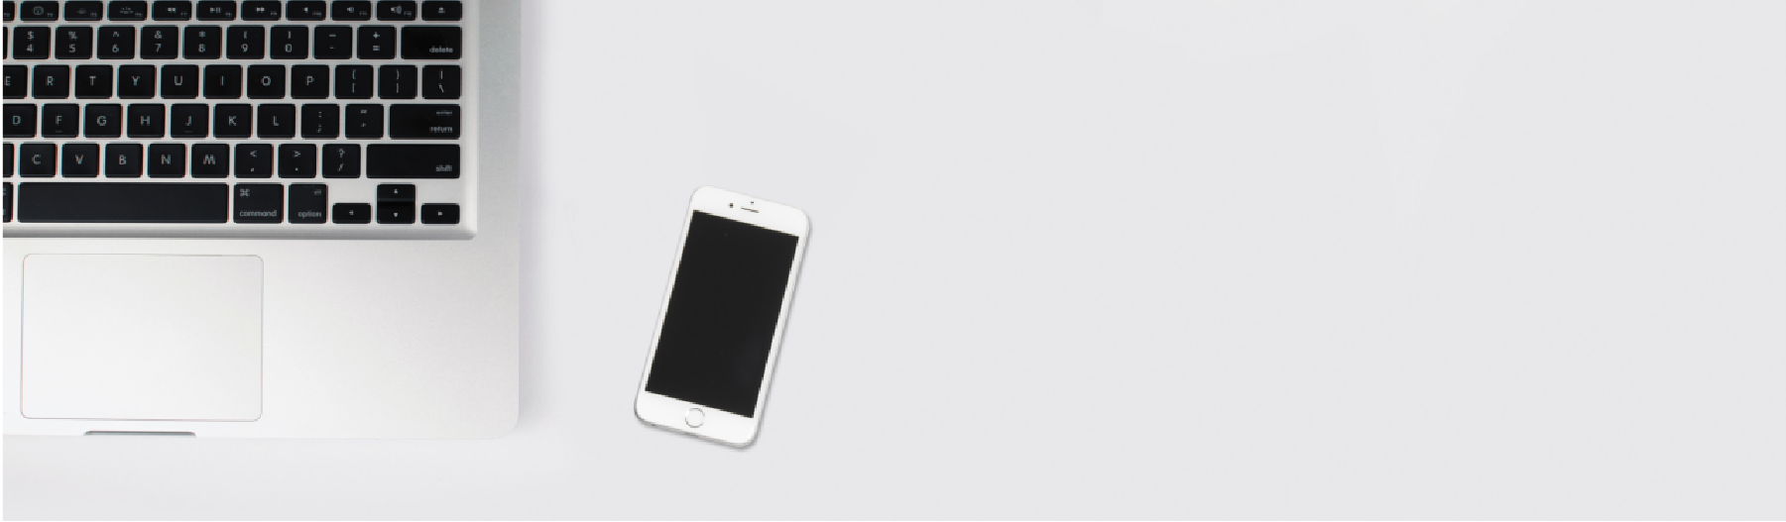
Assignment 9: Cheat Sheet
In this assignment, we explored object detection, analyzing its fundamental concepts, algorithms, and real-world applications in computer vision. We delved into key methods like YOLO, R-CNN, and SSD, examining their unique approaches to detecting and locating objects within images using bounding boxes and confidence scores. The assignment emphasized tools like TensorFlow, Keras, and OpenCV, showcasing their roles in simplifying model creation and training. We also identified common challenges, such as low accuracy and overfitting, and discussed solutions like data augmentation and algorithm selection. This practical experience deepened our understanding of object detection’s significance in technologies like security systems and autonomous vehicles, providing us with valuable insights and a cheat sheet for future reference.

Slide 17


Lab 9: Object Detection using TensorFlow
In this lab, we explored object detection using TensorFlow, focusing on training models with the Pascal VOC 2007 dataset for visual recognition tasks. We utilized Google Colab for its GPU capabilities to handle the computational requirements. The lab involved importing essential libraries, preprocessing data, and training the model using the SSD MobileNet V2 architecture for efficient and fast object detection. We visualized bounding boxes on images and adjusted detection thresholds to refine accuracy. Challenges included managing smaller objects and ensuring accurate labeling. This technology has practical applications in industries such as retail, security, and autonomous vehicles, demonstrating the transformative potential of object detection in real-world scenarios.
Click here to add the text, the text is the extraction of your thought, please try to explain your point of view as succinctly as possible.

Slide 18
Object Detection Group Project
In our group project for the Computer Vision midterm, we collaborated to develop an image recognition model using Convolutional Neural Networks (CNNs) and transfer learning. We began by installing essential libraries, including TensorFlow, OpenCV, Keras, NumPy, and Matplotlib. Our team selected the CIFAR-10 dataset for its accessibility and suitability for image classification tasks. We conducted Exploratory Data Analysis (EDA) to visualize sample images and assess data quality, which helped us understand the distribution of classes within the dataset. This foundational work enabled us to effectively structure our model, leveraging pre-trained architectures to enhance performance and accuracy in recognizing images.

Slide 19
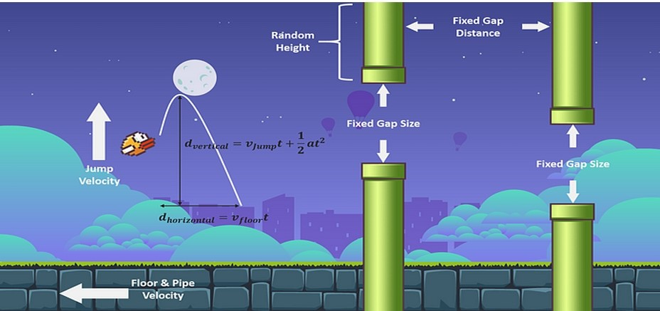
Flappy bird
In our Flappy Bird AI project, we developed an intelligent agent capable of playing the game autonomously using reinforcement learning and transfer learning techniques. We set up the game environment using PyGame and OpenAI Gym, enabling the AI to interact with a simplified version of Flappy Bird. Our approach involved preprocessing game frames, utilizing a pre-trained VGG16 model for feature recognition, and implementing Deep Q-Learning (DQN) for decision-making. We addressed challenges such as sparse rewards and overfitting through techniques like experience replay and target networks. The AI's performance was evaluated based on average score and survival time, with results visualized using graphs and heatmaps. Key insights included the importance of balancing exploration and exploitation, and the effectiveness of transfer learning in accelerating the AI's learning process. This project not only demonstrated the potential of AI in game playing but also highlighted the complexities involved in training an agent to master a seemingly simple game.

Slide 20
Github Link

